Slide 1


GOVERNMENT ENGINEERING COLLEGE
RAICHUR-584135
Welcome to Internship Seminar presentation
On
“ Weight Prediction using Simple Linear Regression”
Presented by
ChandraShekhara
3GU19CS007
Under the guidance of
PROF. SUSHMA T SHEDOLE
Asst. Professor,
Department of Computer Science &
Engineering

Slide 2




Slide 3
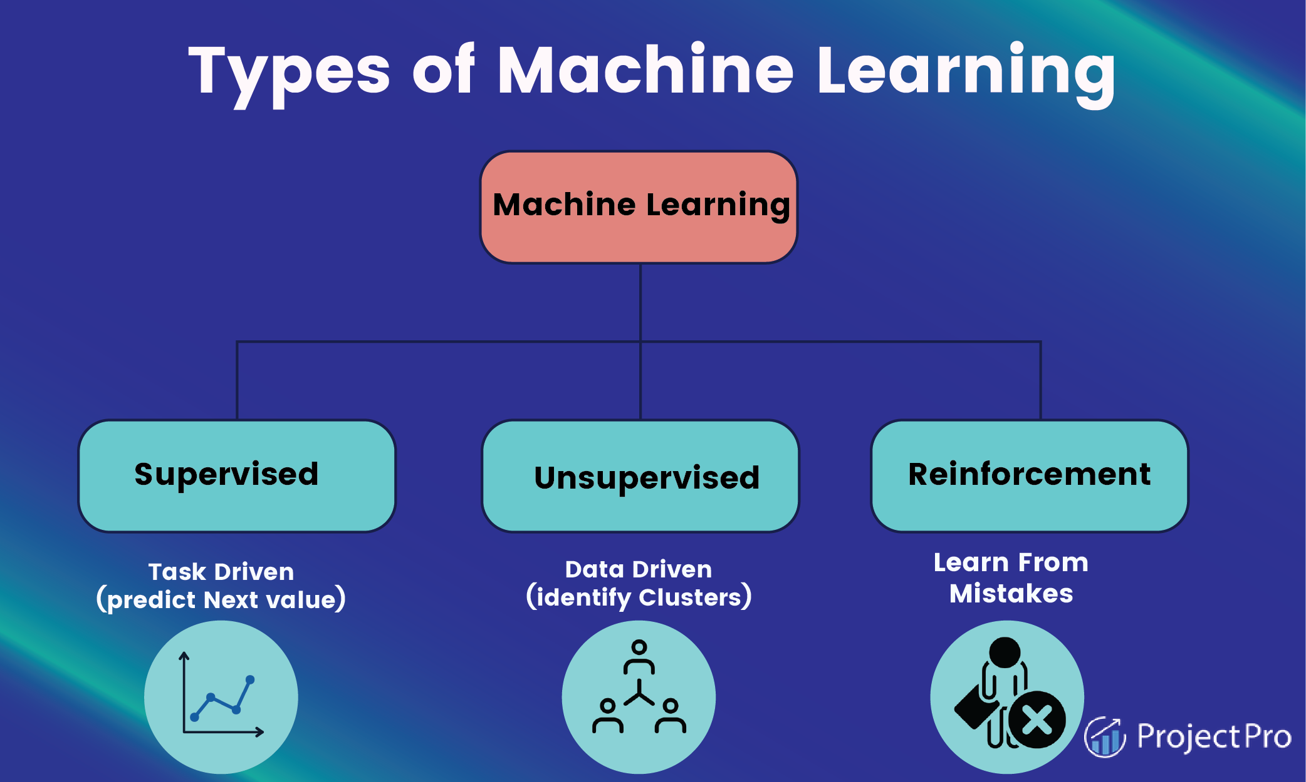

Slide 4
Introduction
R is a
A Programming Language
A Statistical Package
An Interpreter
Open Source
Object Oriented Language

Slide 5
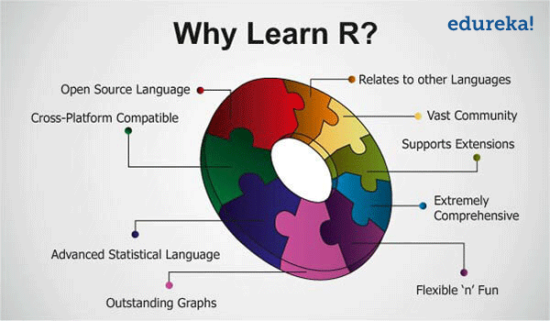

Slide 6
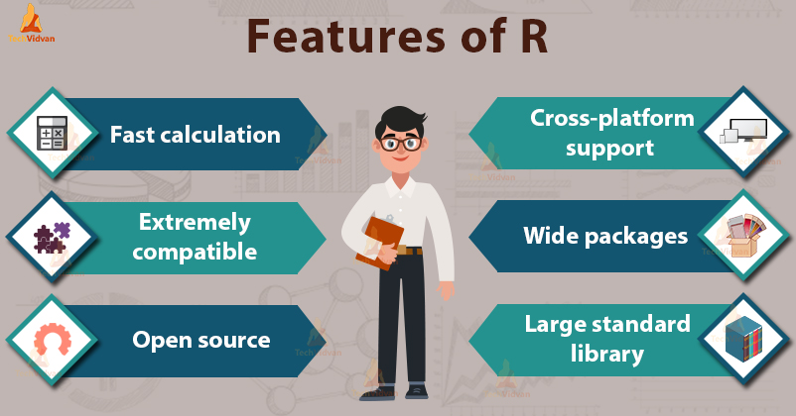

Slide 7
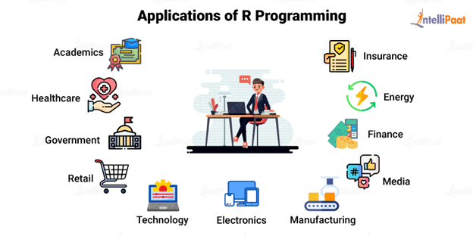




Slide 8
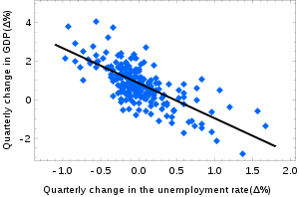
Simple linear regression
Simple linear regression is a regression model that estimates the relationship between one independent variable and one dependent variable using a straight line.
Simple linear regression is a parametric test, meaning that it makes certain assumptions about the data.
The relationship between the independent and dependent variable is linear: the line of best fit through the data points is a straight line (rather than a curve or some sort of grouping factor).
The equation has the form Y= a + bX, where Y is the dependent variable (that's the variable that goes on the Y axis), X is the independent variable (i.e. it is plotted on the X axis), b is the slope of the line and a is the y-intercept.

Slide 9
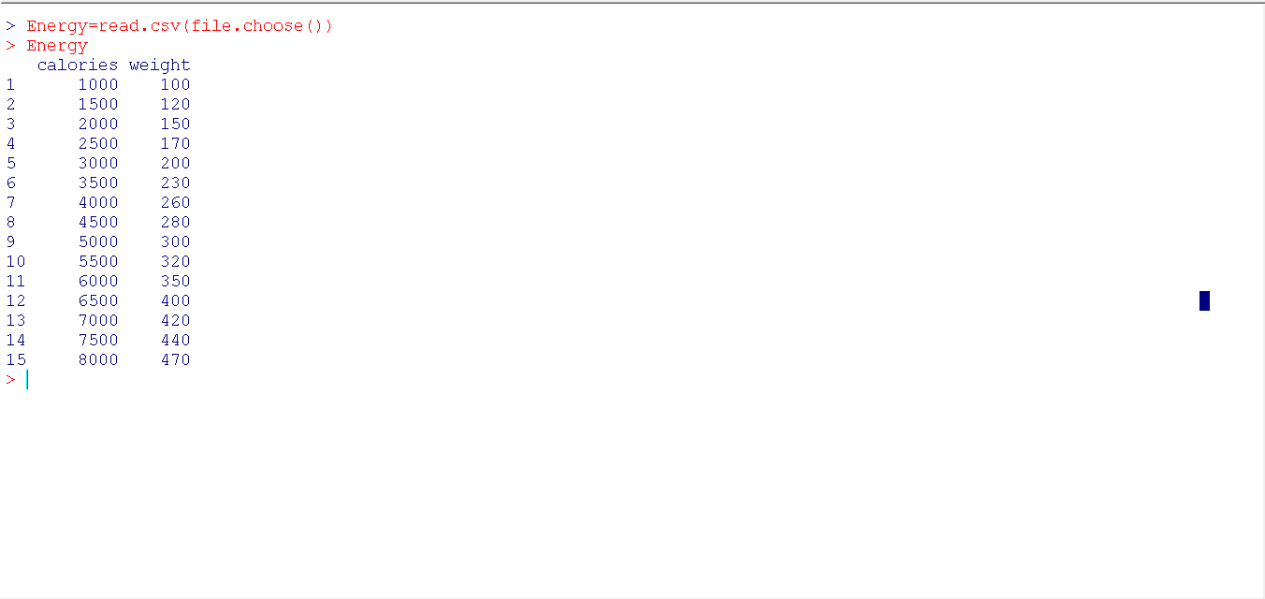
Import Dataset into R

Slide 10
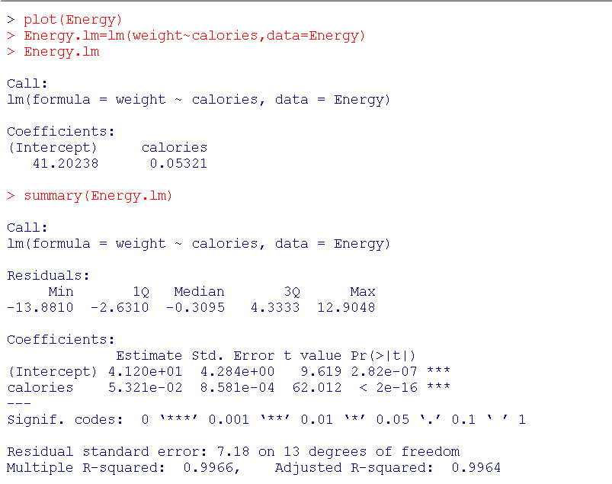
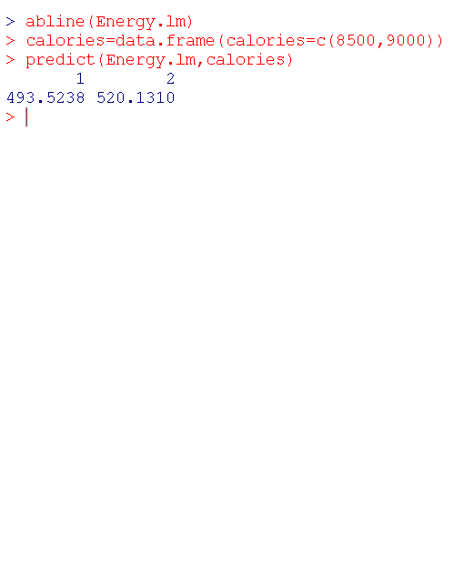
Commands of Simple Linear Regression

Slide 11
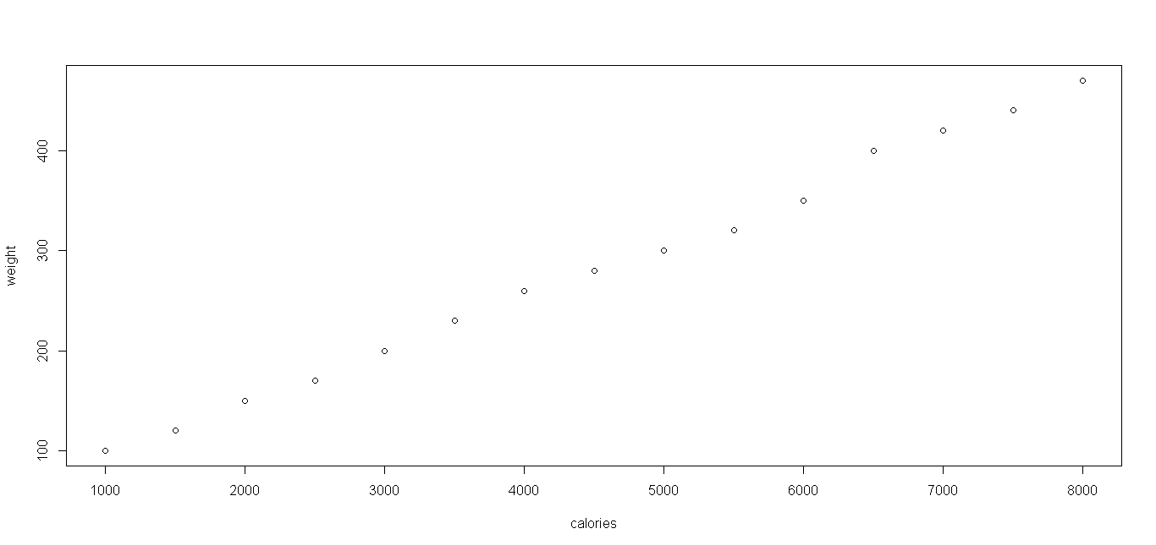
Scatter chart for Energy Dataset

Slide 12
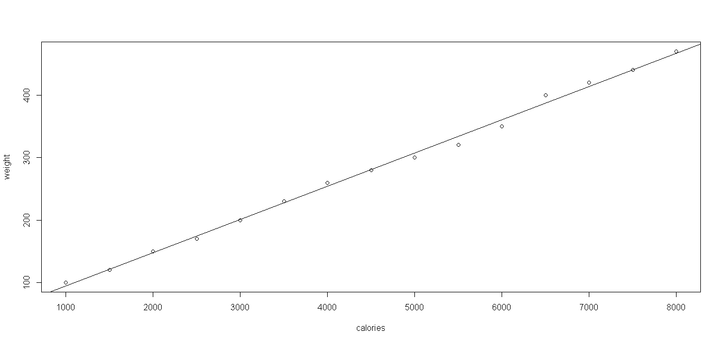
Prediction Line for Energy Dataset

Slide 13
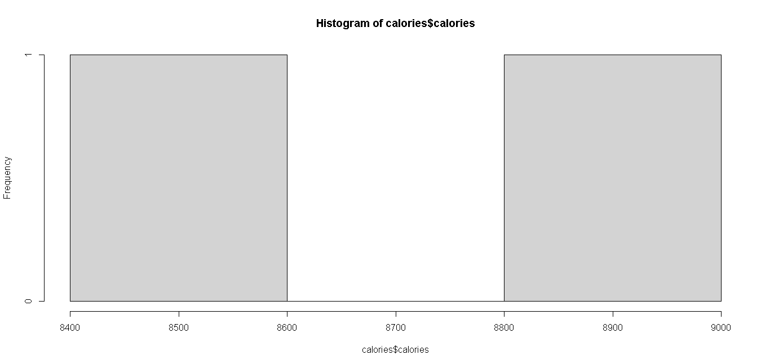
Hist(calories$calories)

Slide 14
CONCLUSION

Slide 15
REFERENCE

